Slide 1



SS2.34 Engaging Researchers in the Net-Zero Transition
Guillermo Cisneros
Rector of Universidad Politécnica de Madrid
and Chair of the Taksforce Sustainability of CESEAR

Slide 2

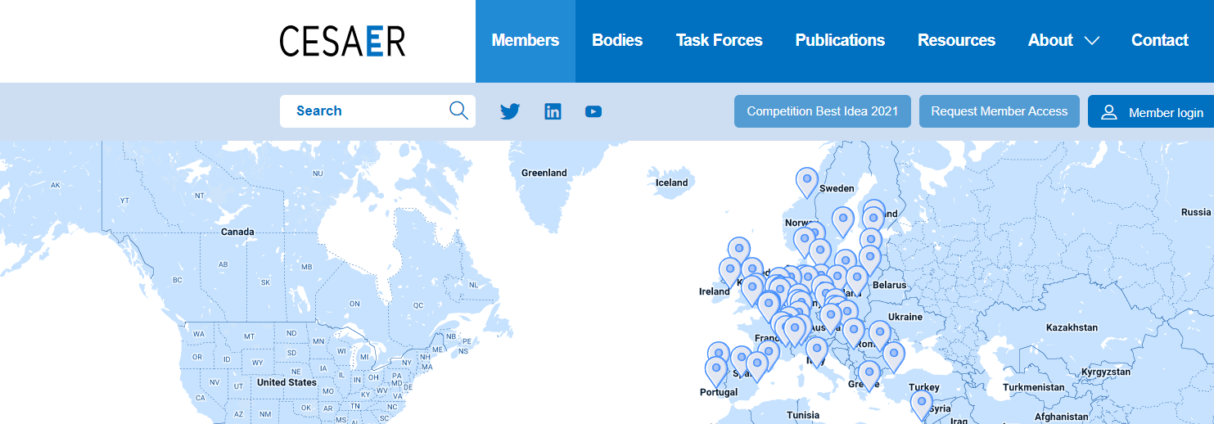

Sustainability Taskforce
54 Science and Technology Universities
Preparing a White Paper
Issue a declaration in Madrid 2023
Participate in COP27
For our Universities:
Research for sustainability
Education for sustainability
Innovation for sustainability
Global framework for S&T cooperation and engagement for sustainable future

Slide 3
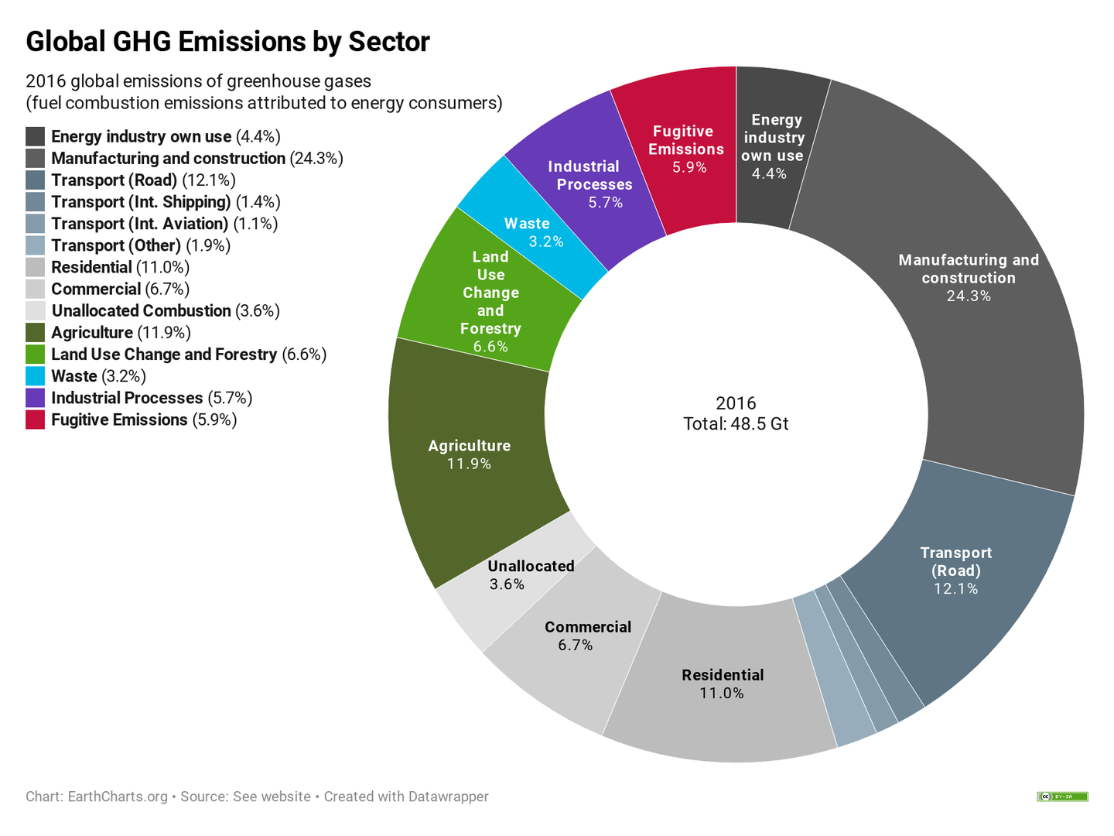
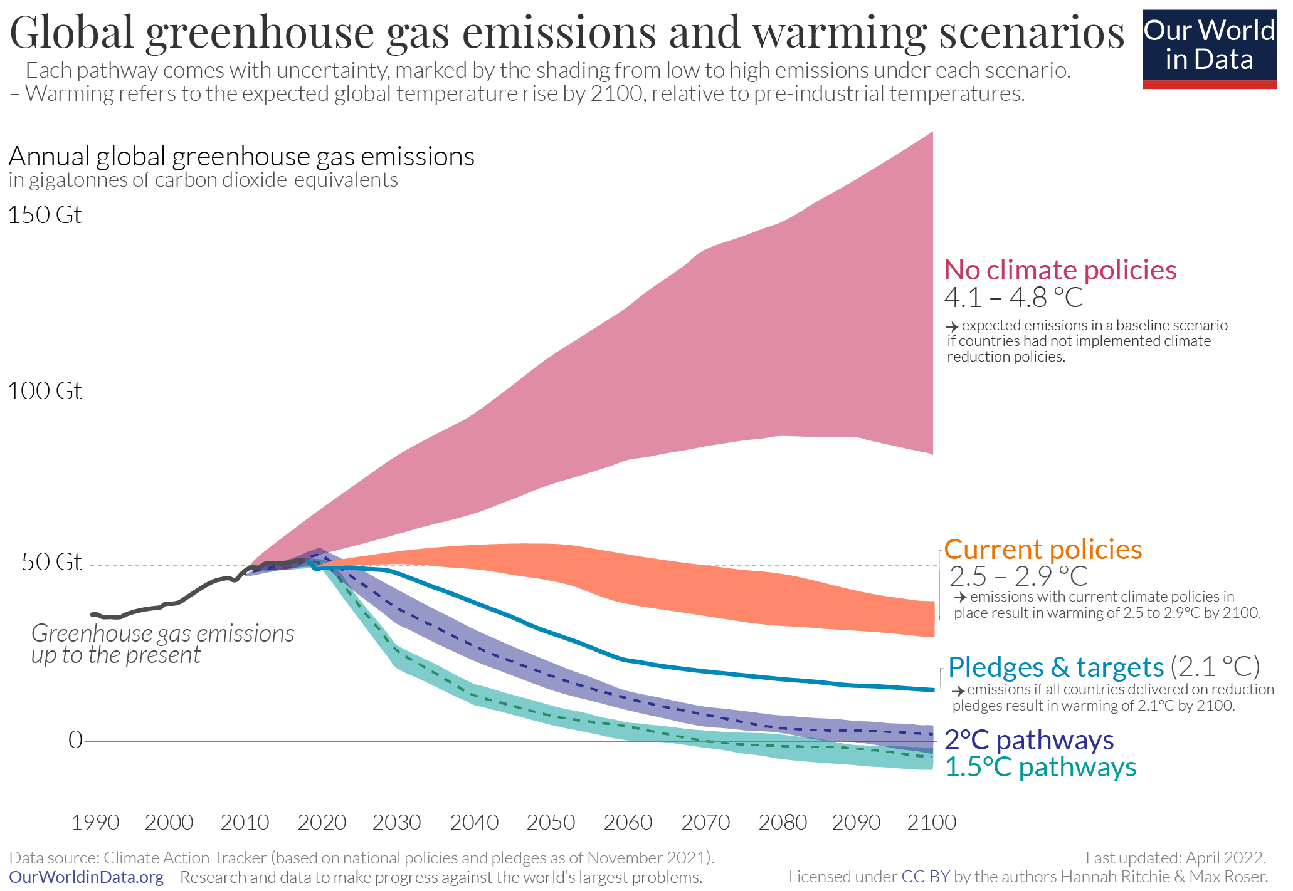
Inter-disciplinarity
Net-zero transition requires reducing GHGs and C-storage and sequestration
By Simon Rayner / EarthCharts - EarthCharts Website (http://earthcharts.org/), http://earthcharts.org/wp-content/uploads/2020/03/Emissions-Sources.png, CC BY-SA 4.0, https://commons.wikimedia.org/w/index.php?curid=87783234

Slide 4
Inter-disciplinarity
Net-zero transition requires reducing GHGs and C-storage and sequestration
Reduction of GHGs:
  Building
  Transportation
  Manufactuting
  Energy (efficiency and storage)
  Agriculture (and the Bioeconomy)
  Circular economy
  Transforming human behaviour
C-storage and capture
  Carbon soil
  Biomass
  Geoengineering solutions

Slide 5
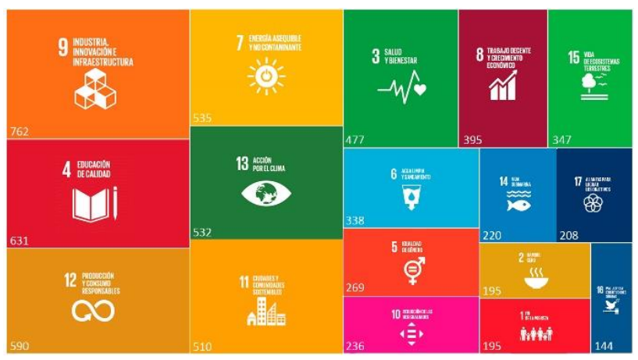
Our organisations’ mission
Education
  Our programmes MUST pay attention to CC, each in its domains and disciplines and beyond
  Students projects (MSs, B.Eng, Doctoral Theses)
Education and the SDGs at UPM
BACHELOR OF ENG AND MASTER THESIS GRANTS PROMOTING SUSTAINABILITY AT UPM CAMPUSES
Calls made since Academic year 2016/2017
So far more than 70 grants have been granted to UPM students

Slide 6
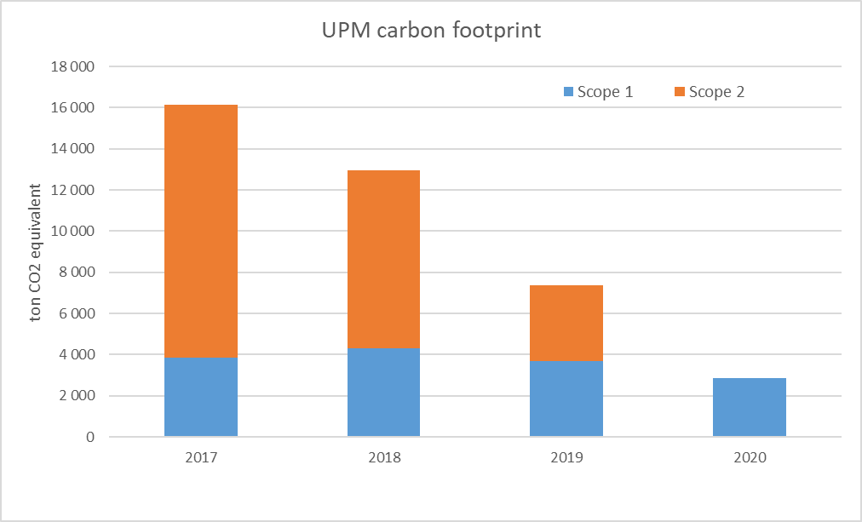
Our organisations’ mission
Internal management – show and accredit progress in net-zero transition
Scope 2. Indirect emissions
Scope1.
Direct emissions

Slide 7
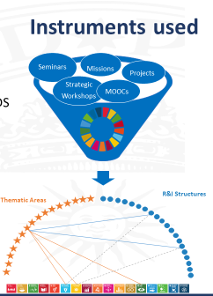
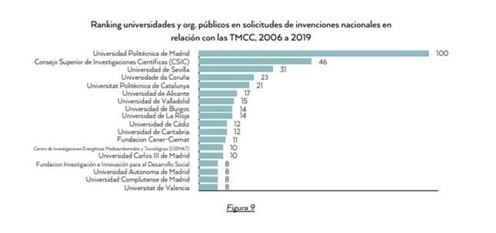
Our organisations’ mission
Research & Innovation
#1 position in patents related to climate change mitigation

Slide 8
Collaboration
Create critical mass
Share experience and learn from others
Joint efforts, summing expertise
Pool investment risks and multiply research strategies
Engaging in multi-actor partnerships

Slide 9
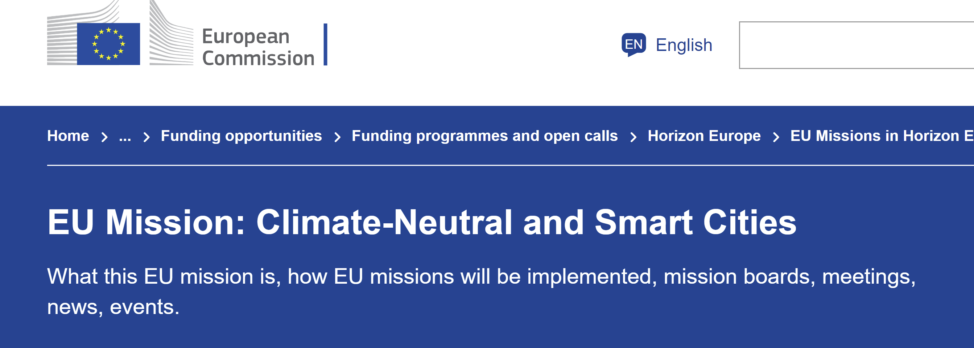
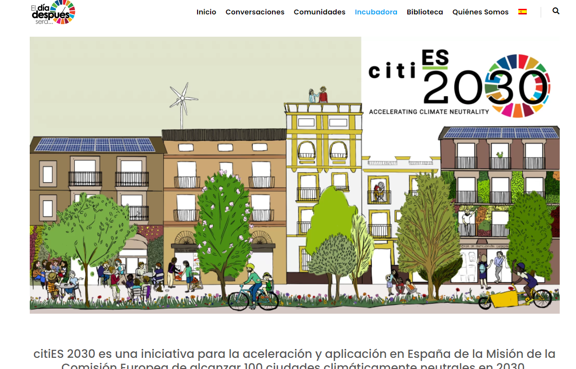
Collaboration
Engaging in multi-actor partnerships

Slide 10


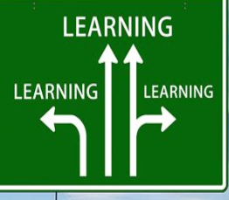
Collaboration
CESEAR Task Force Sustainability 2022-2023 :
    Inspire our Members and other universities of S&T about their contribution to knowledge societies for a sustainable future
    Advocate the corresponding framework conditions for optimising the contribution of universities of S&T to policy makers and funders
  Learn from each other and promote best practice when contributing to knowledge societies for a sustainable future.

